Slide 1

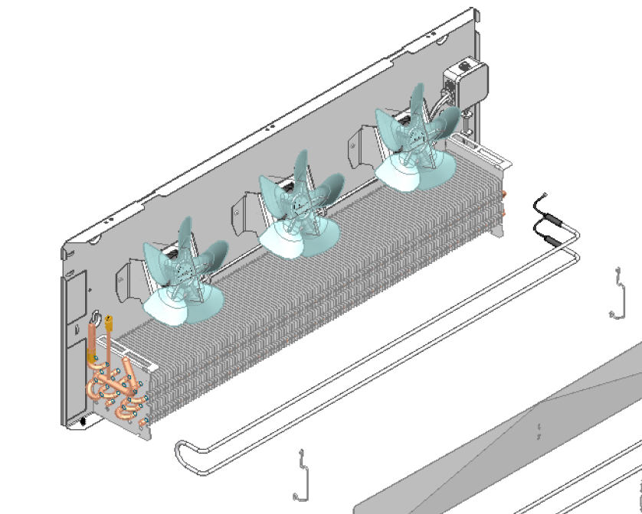

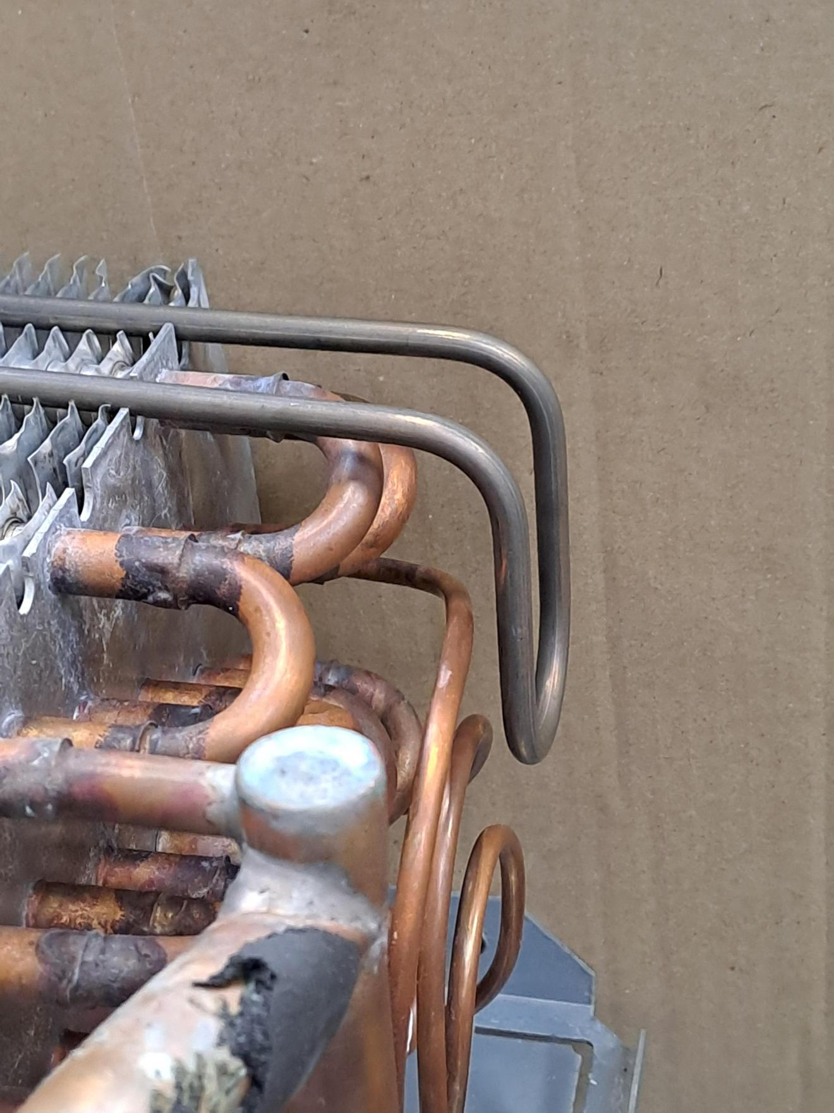
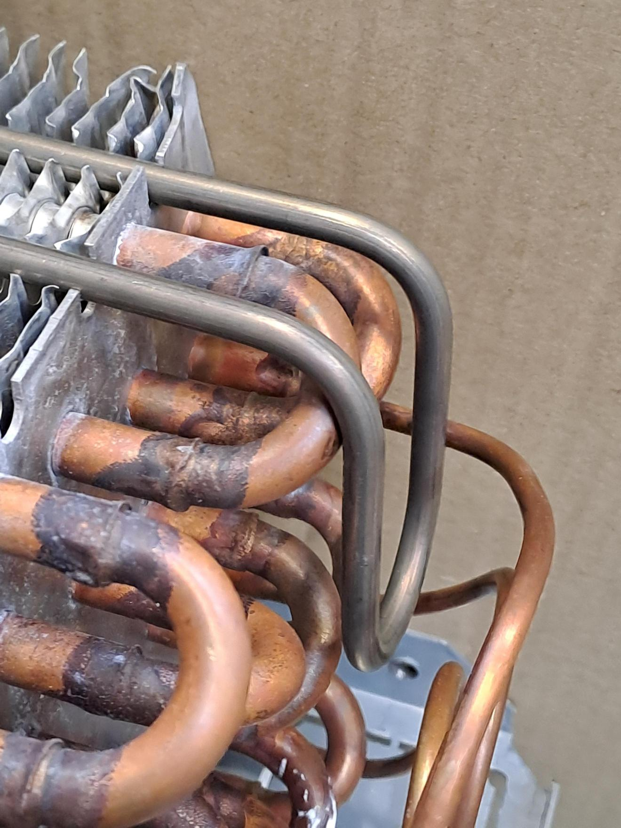
AZUR electrical heater positioning.
Position on the distributor side.
1
Position the bend of the electrical heater inside the leads
2
(2)
(1)
1
2
1
2

Slide 2
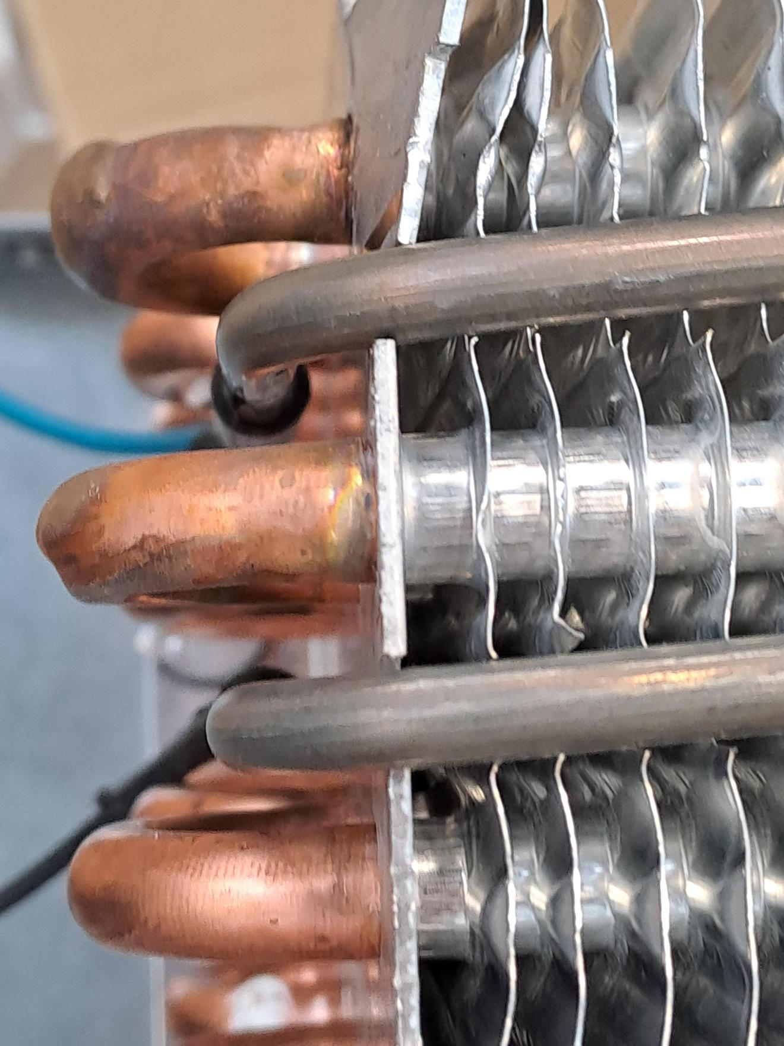
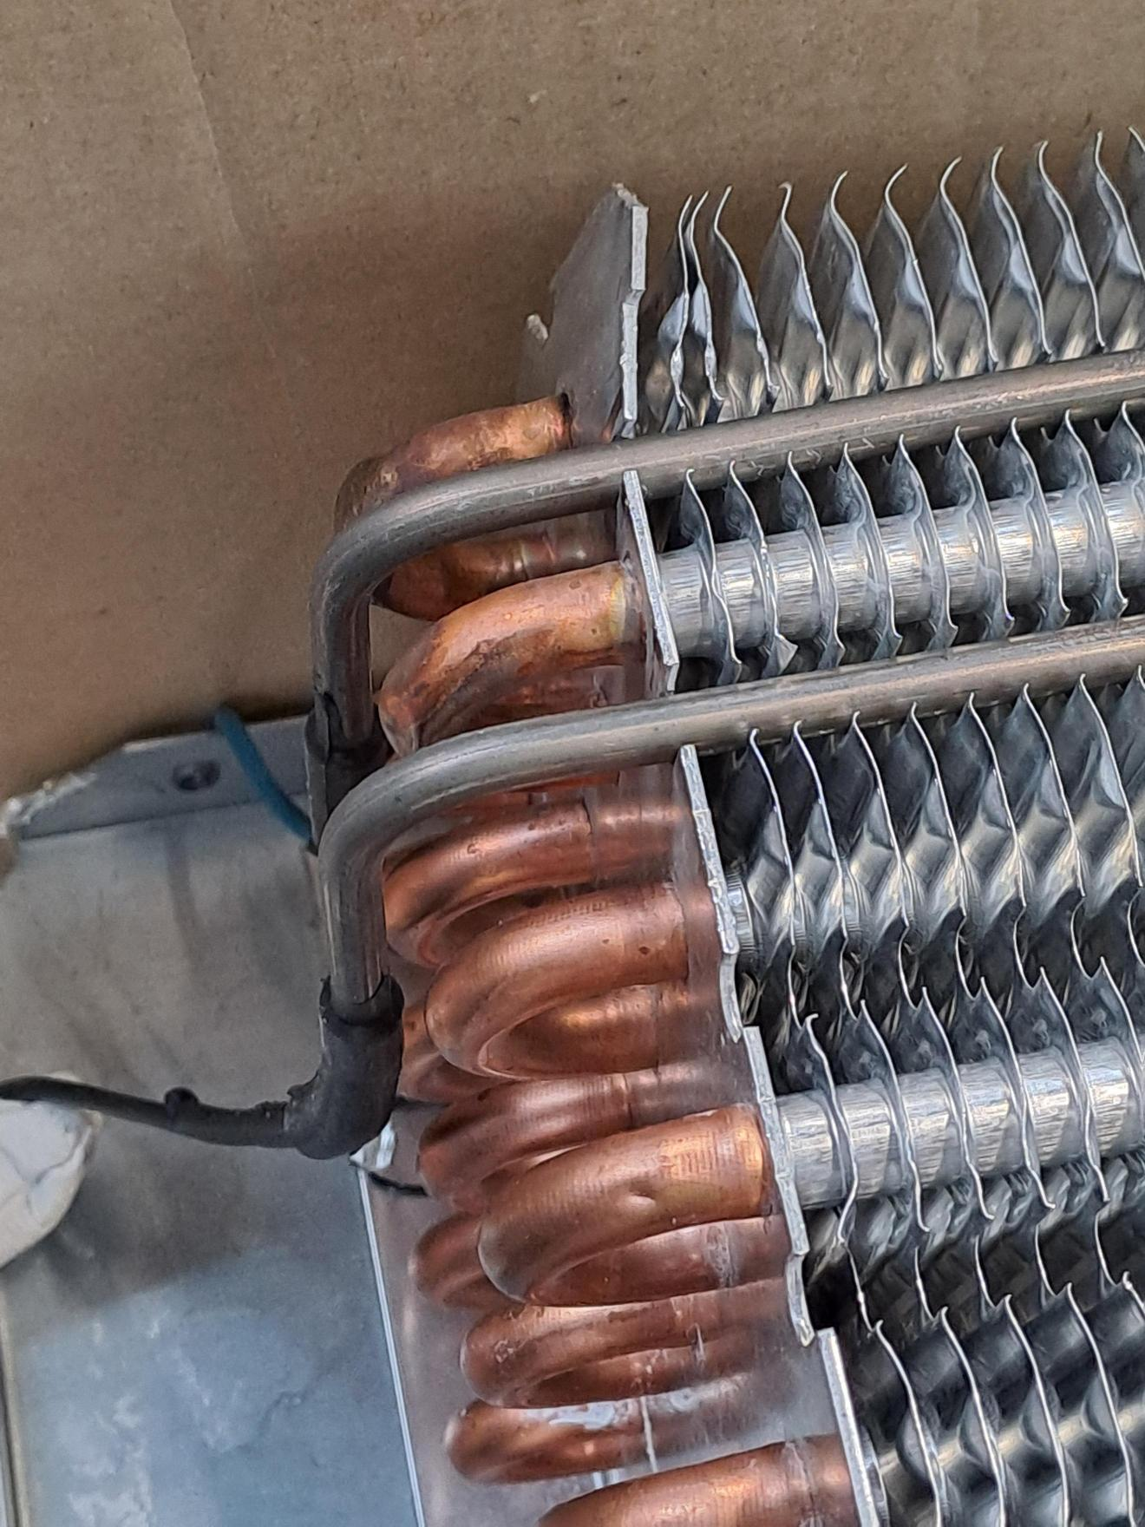
AZUR electrical heater positioning.
Position on the hairpin side.
1
Position the bend of the electrical heater outside the elbows
(2)
2
(1)
1
1
2
2

